Slide 1
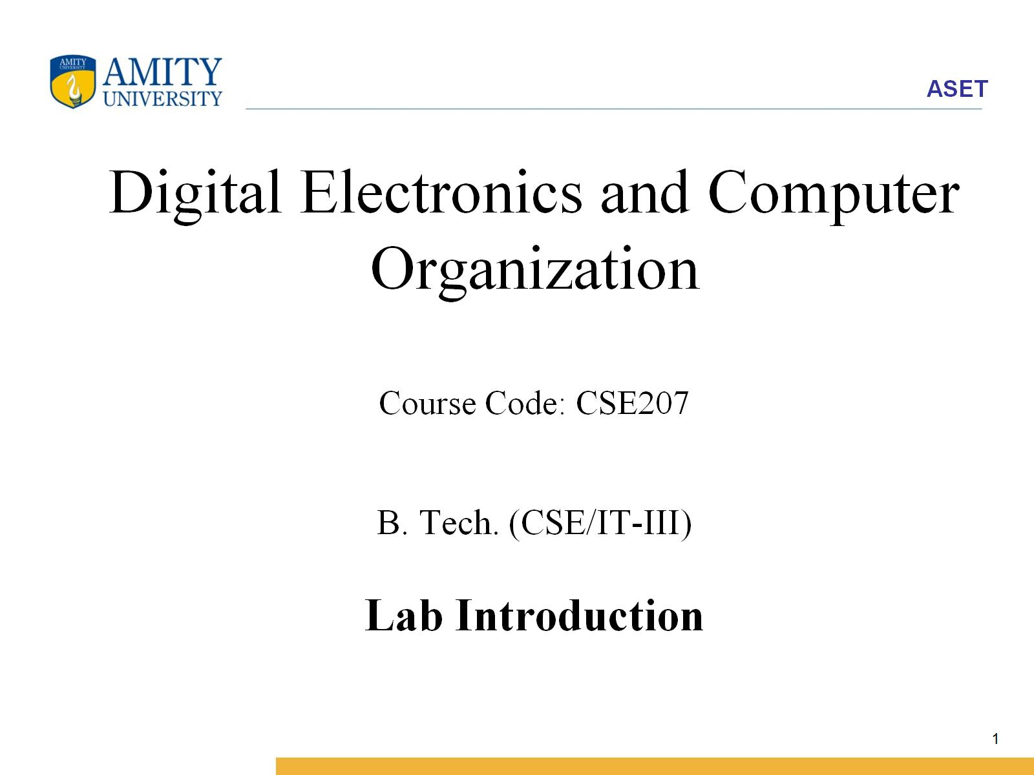
Digital Electronics and Computer Organization Course Code: CSE207 B. Tech. (CSE/IT-III) Lab Introduction

Slide 2
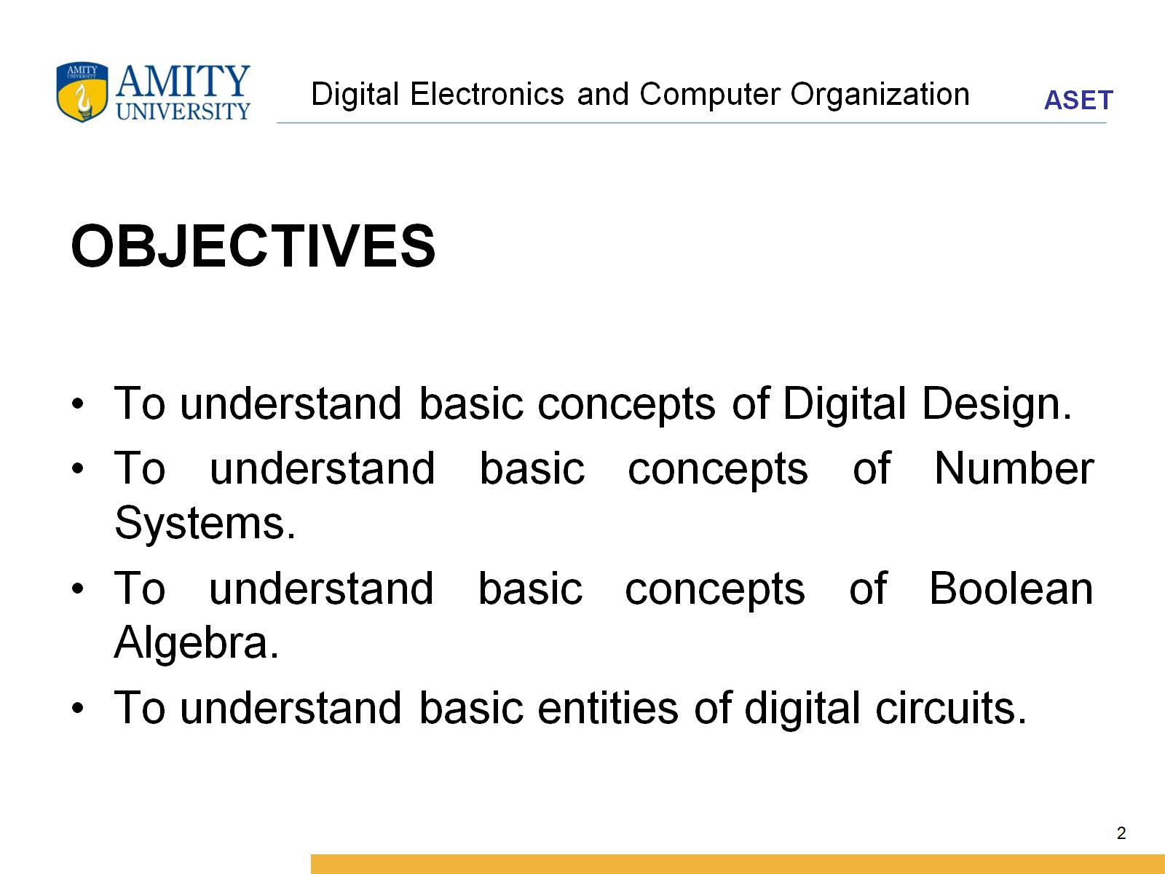
Digital Electronics and Computer Organization

Slide 3
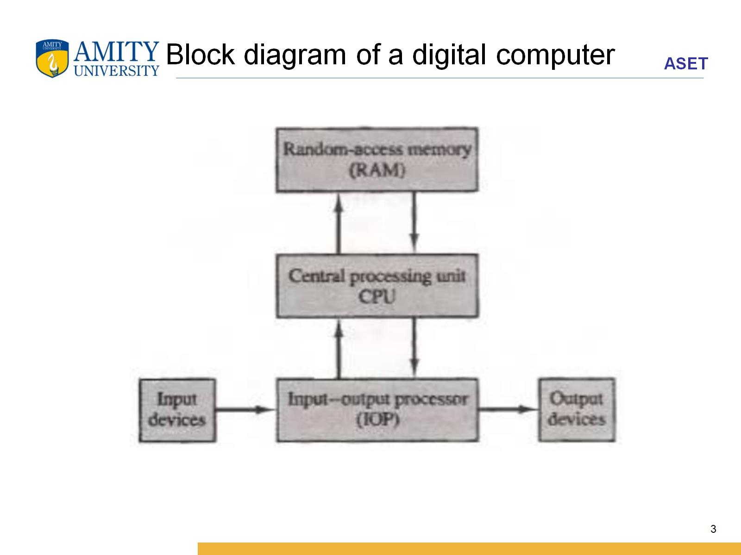
Block diagram of a digital computer

Slide 4
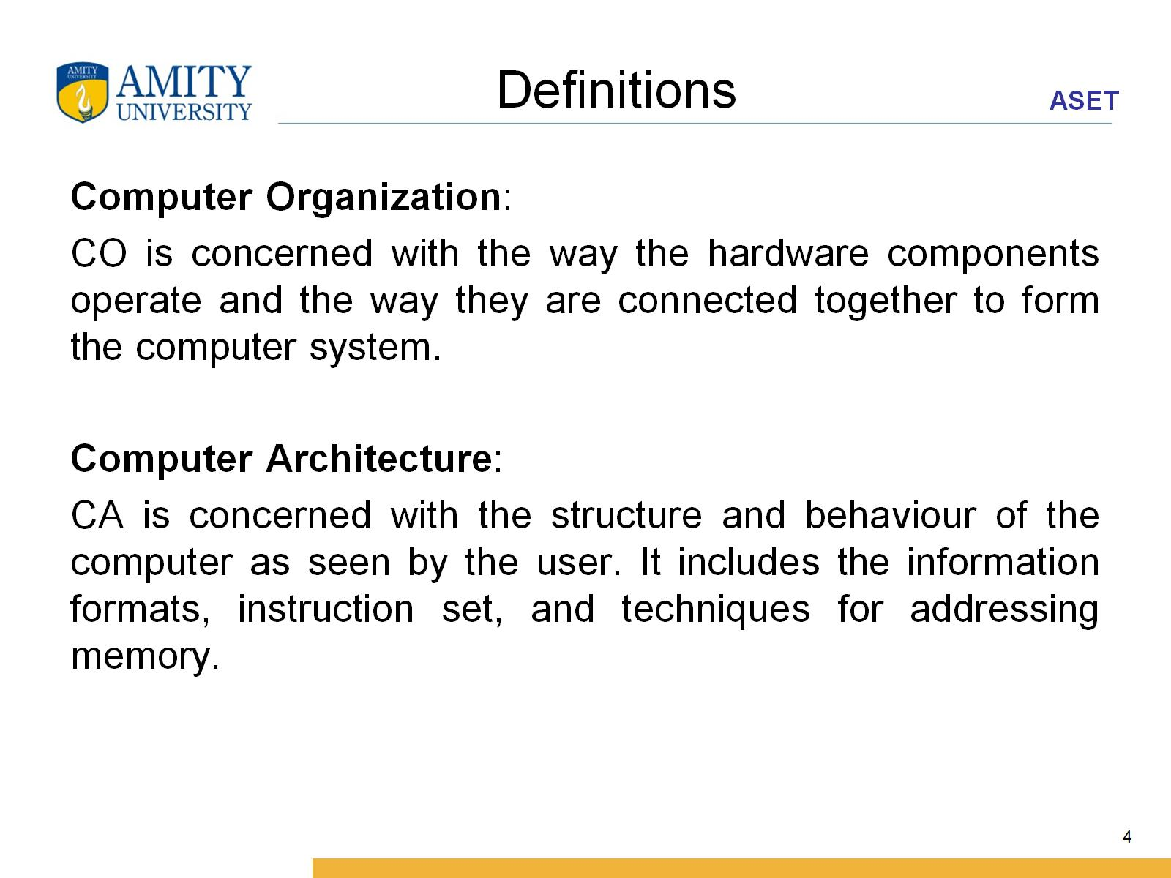
Definitions

Slide 5
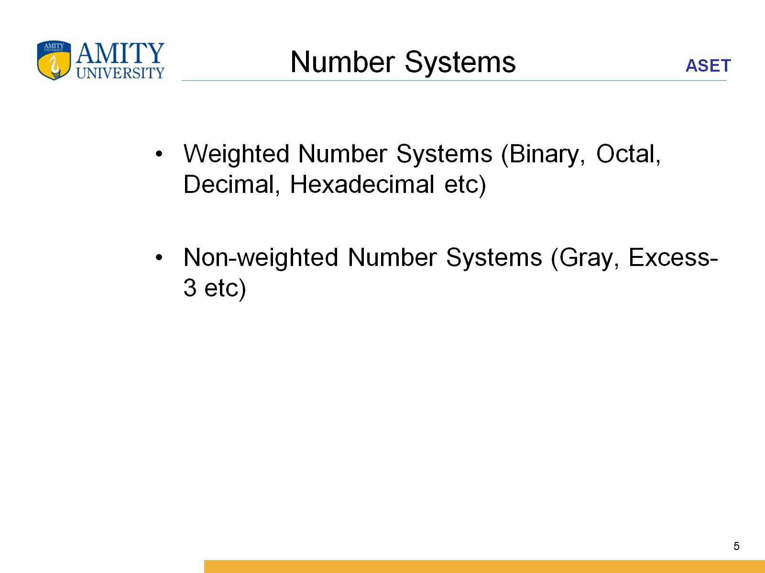
Number Systems

Slide 6
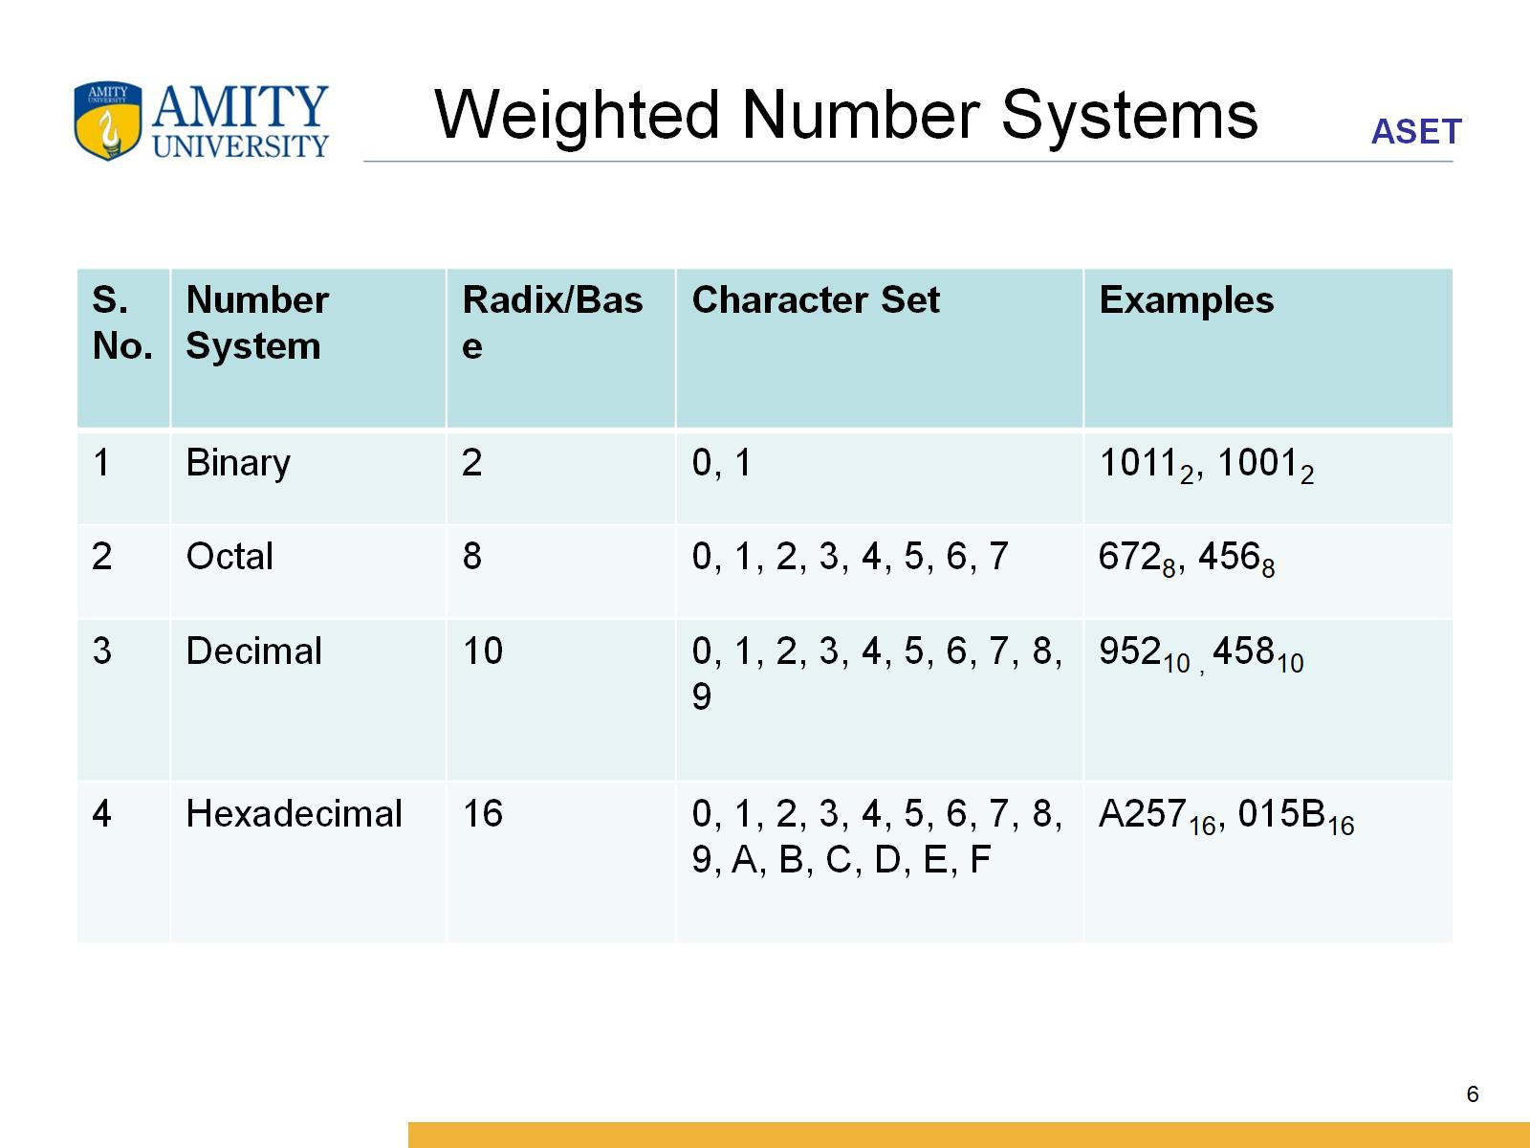
Weighted Number Systems

Slide 7
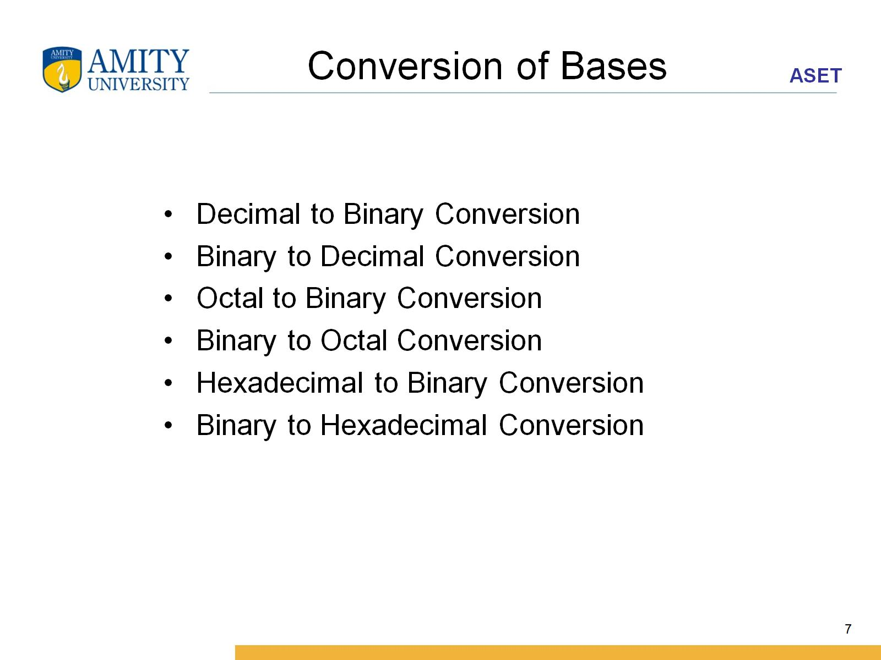
Conversion of Bases

Slide 8
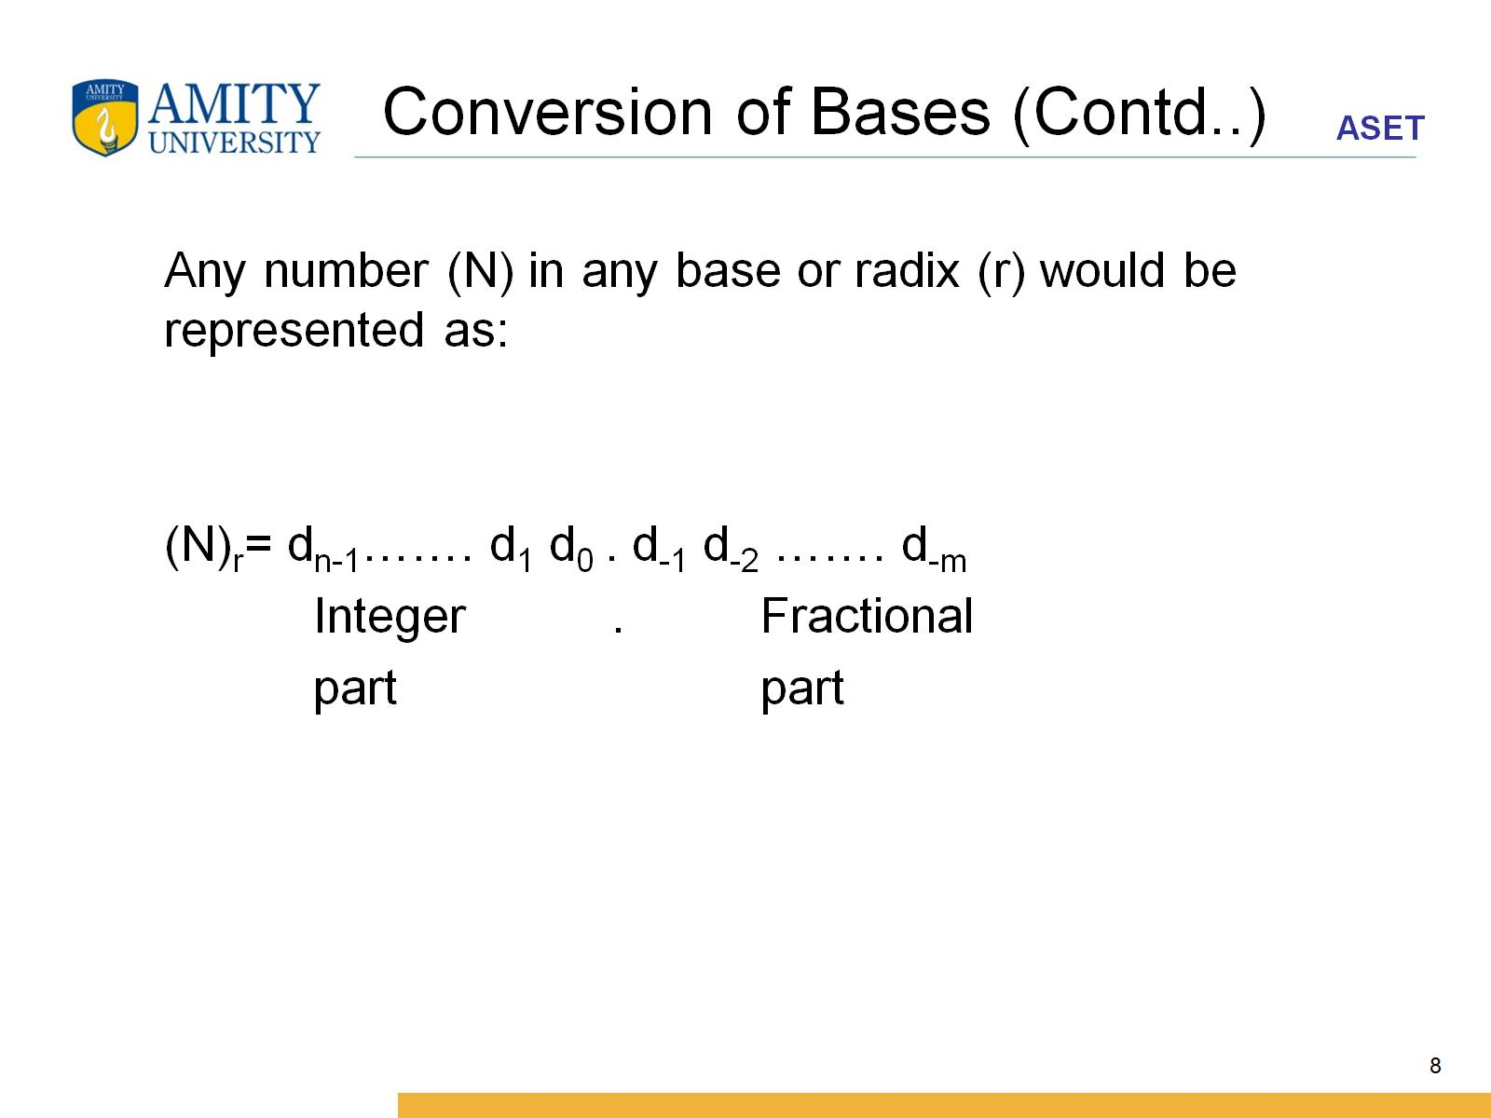
Conversion of Bases (Contd..)

Slide 9
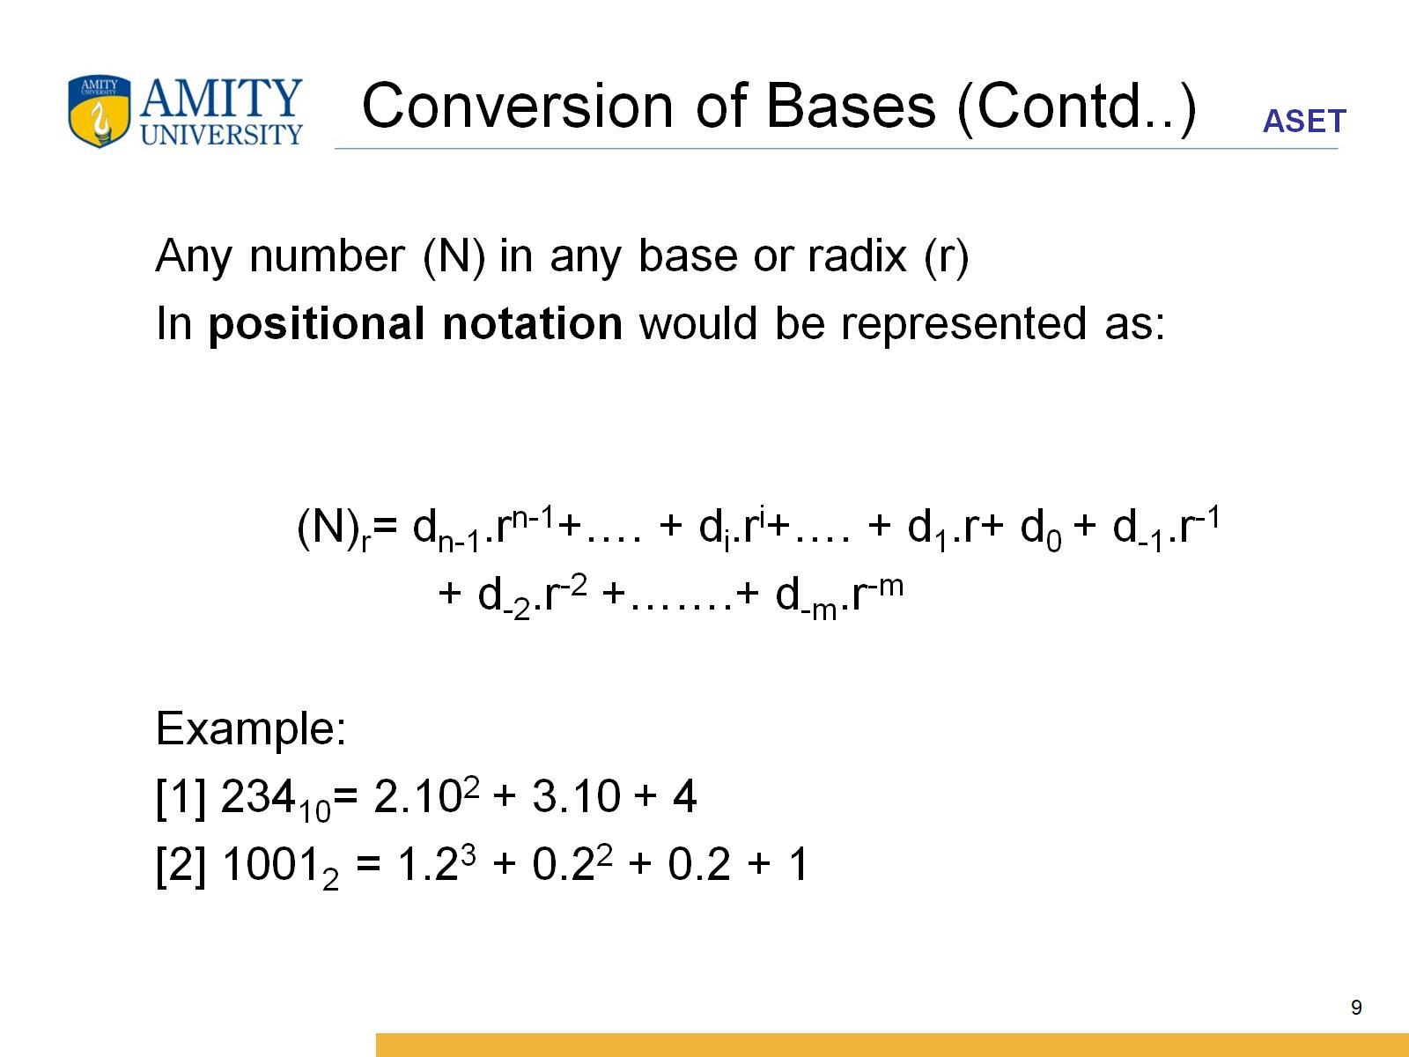
Conversion of Bases (Contd..)

Slide 10
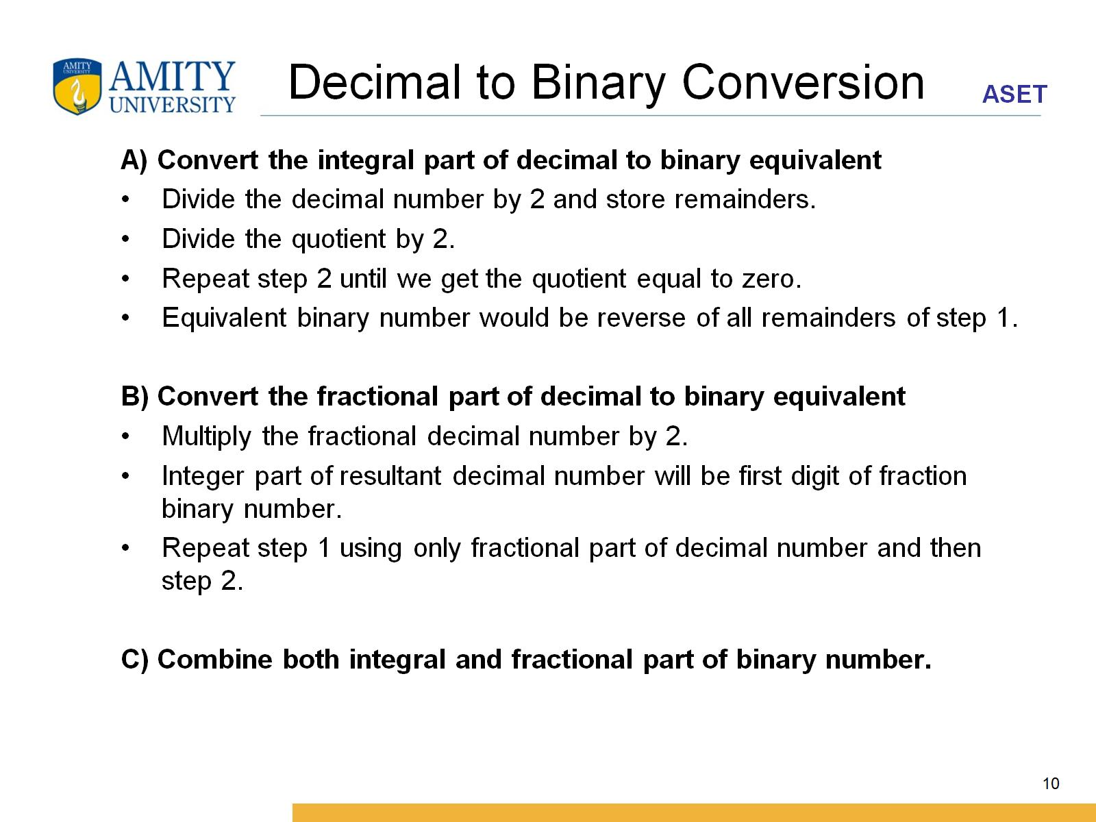
Decimal to Binary Conversion

Slide 11
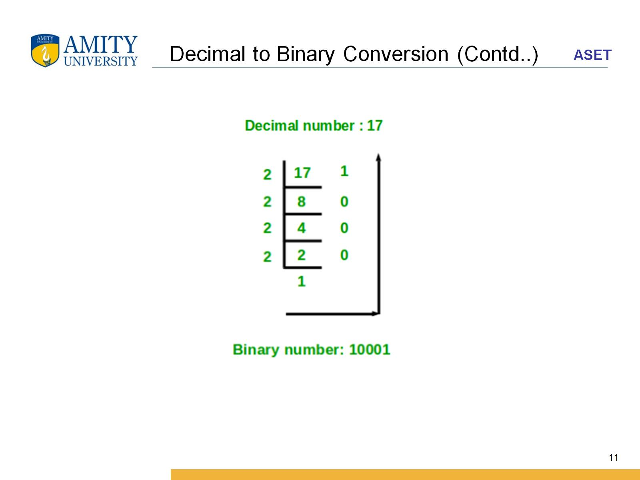
Decimal to Binary Conversion (Contd..)

Slide 12
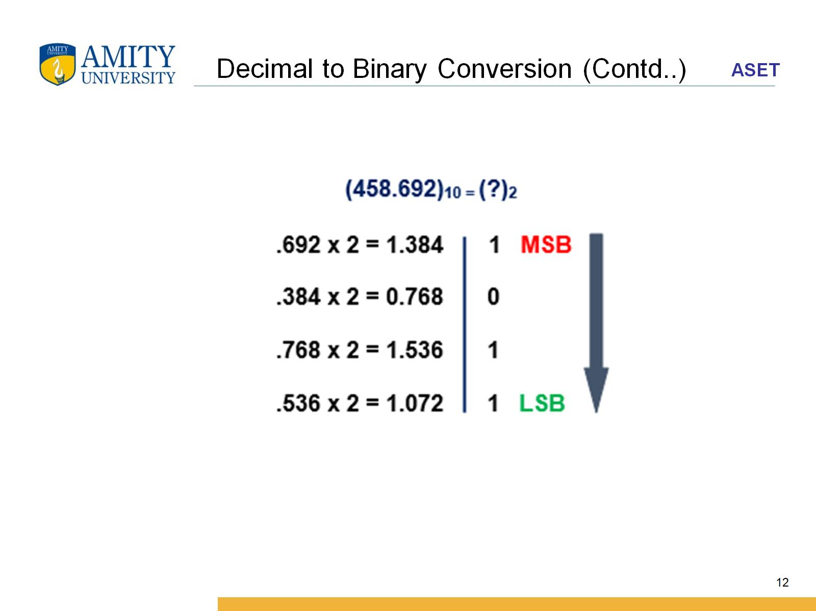
Decimal to Binary Conversion (Contd..)

Slide 13
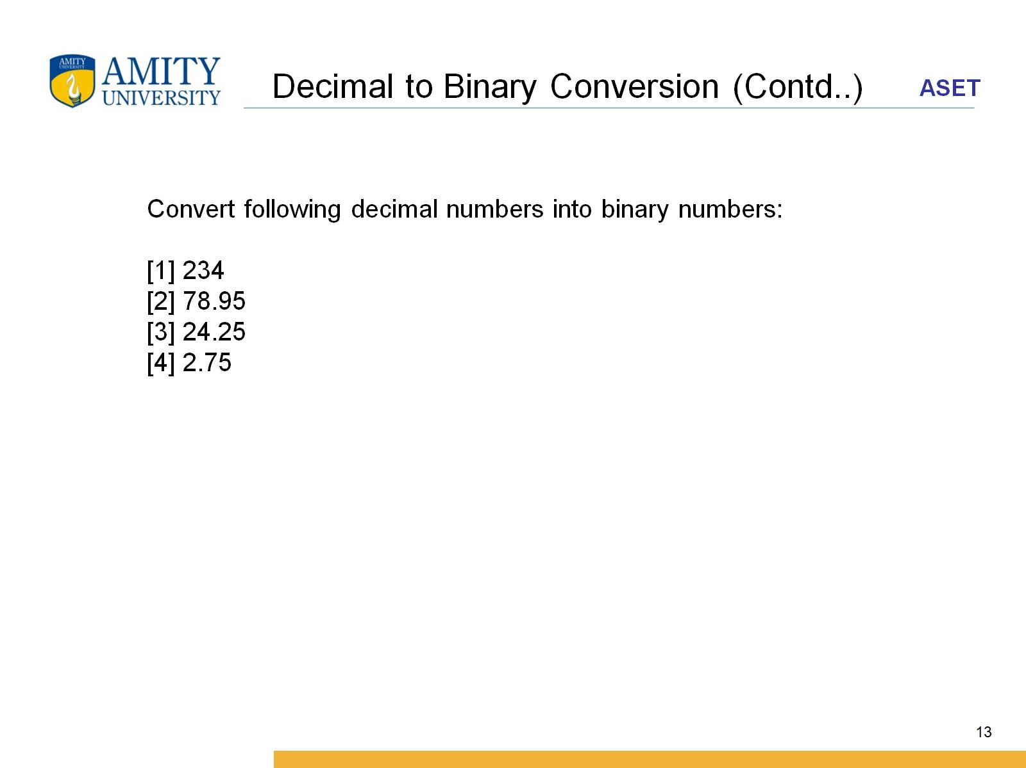
Decimal to Binary Conversion (Contd..)

Slide 14
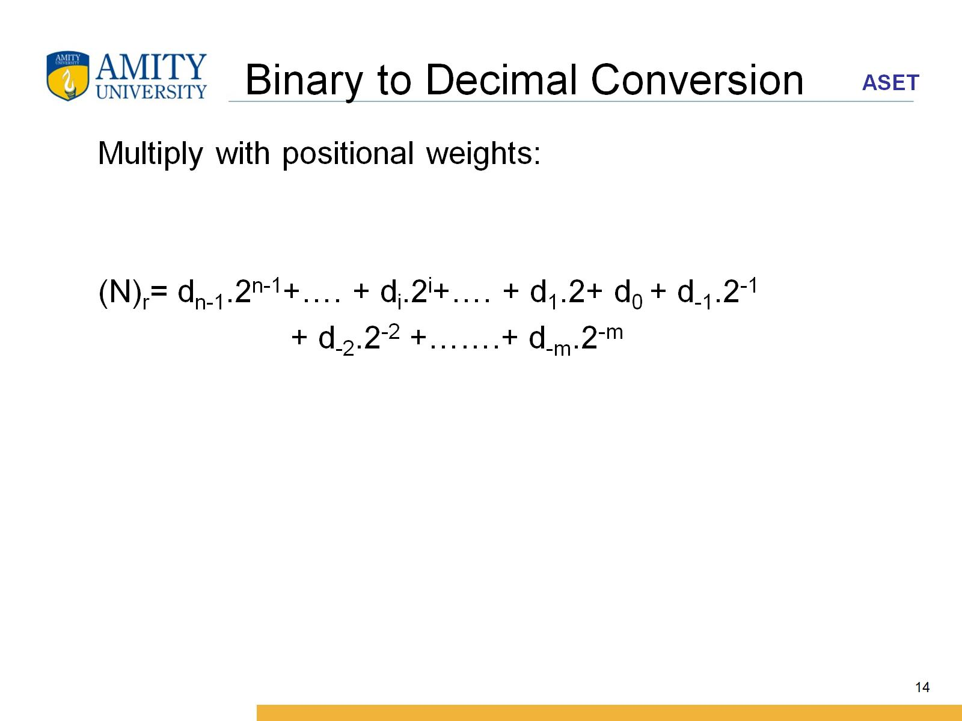
Binary to Decimal Conversion

Slide 15
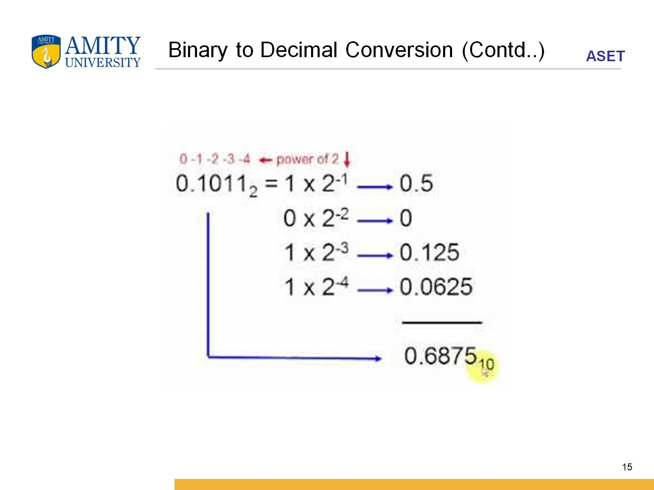
Binary to Decimal Conversion (Contd..)

Slide 16
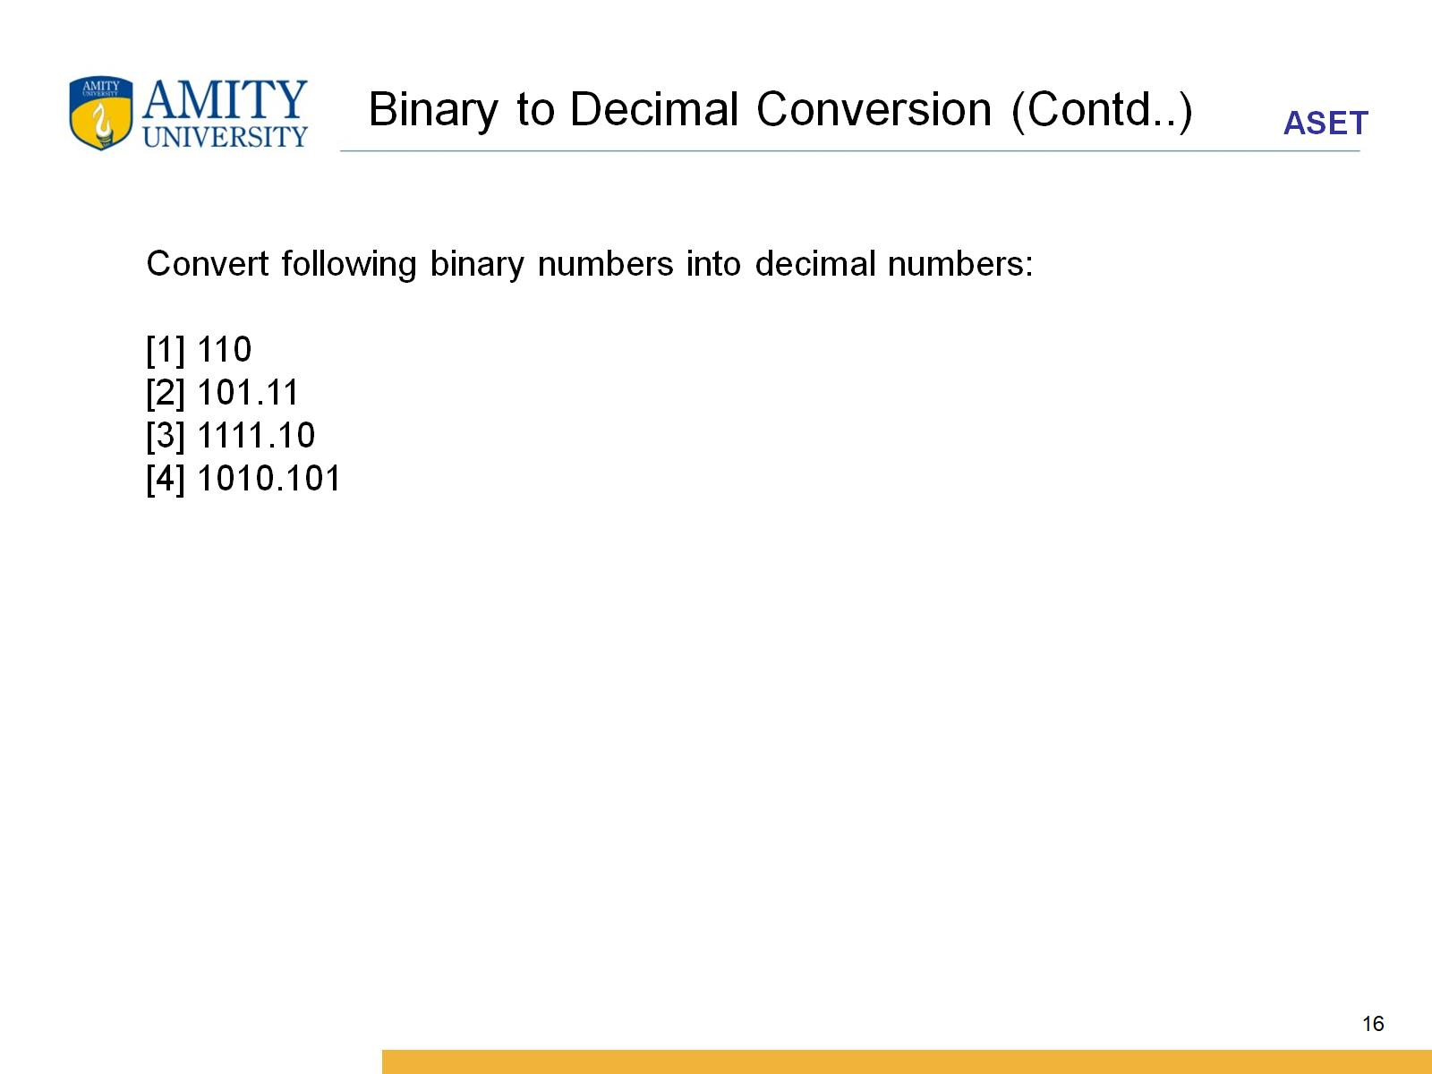
Binary to Decimal Conversion (Contd..)

Slide 17
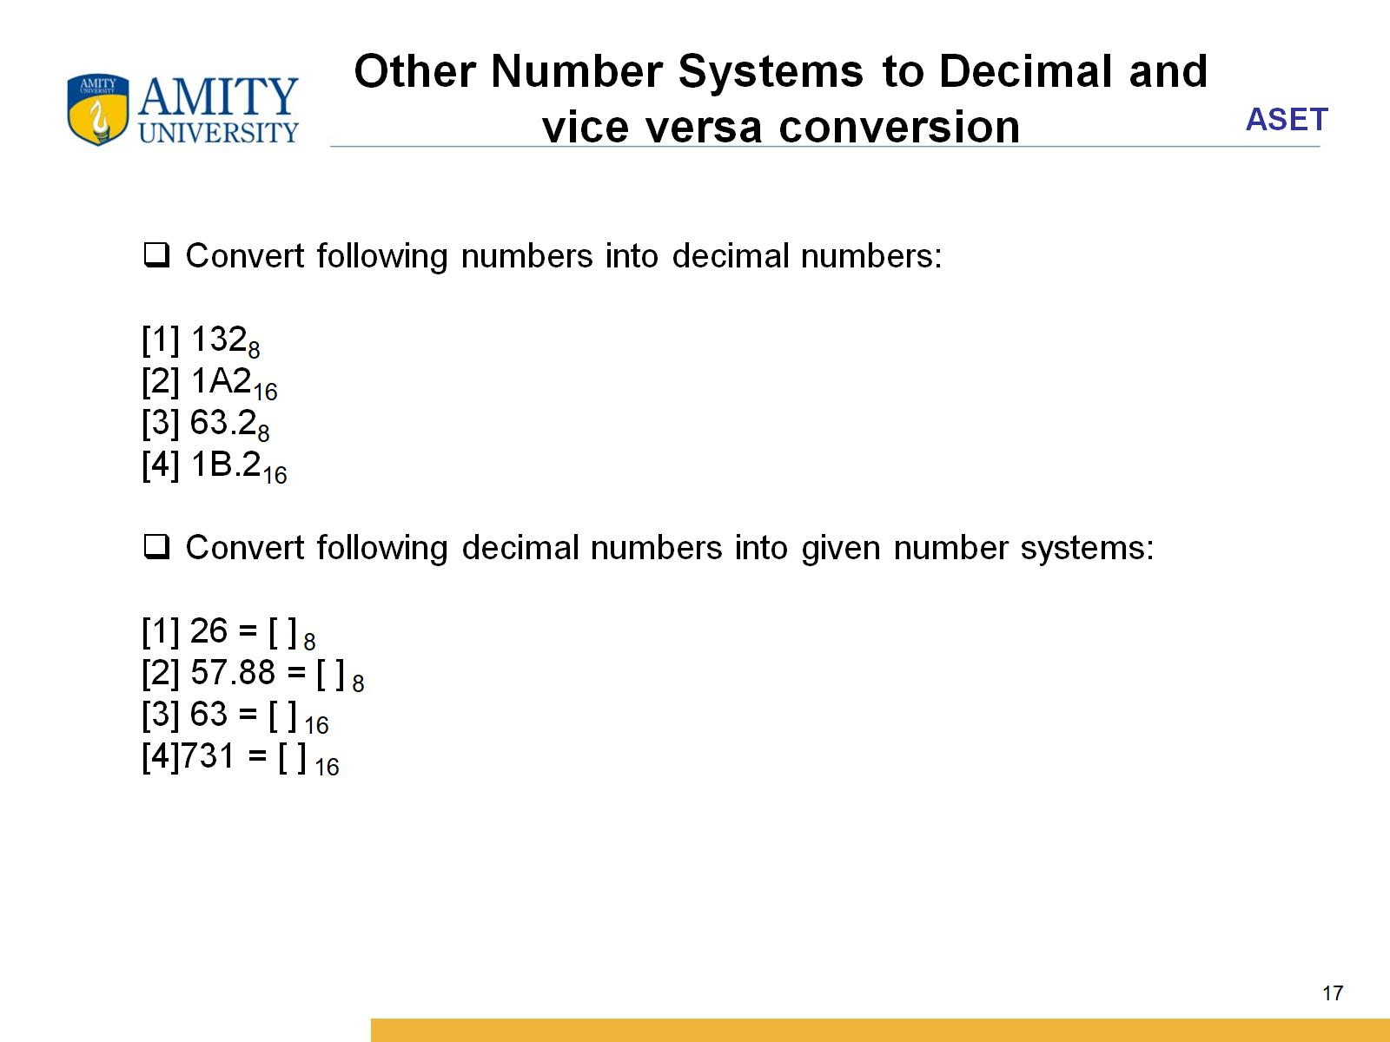
Other Number Systems to Decimal and vice versa conversion

Slide 18
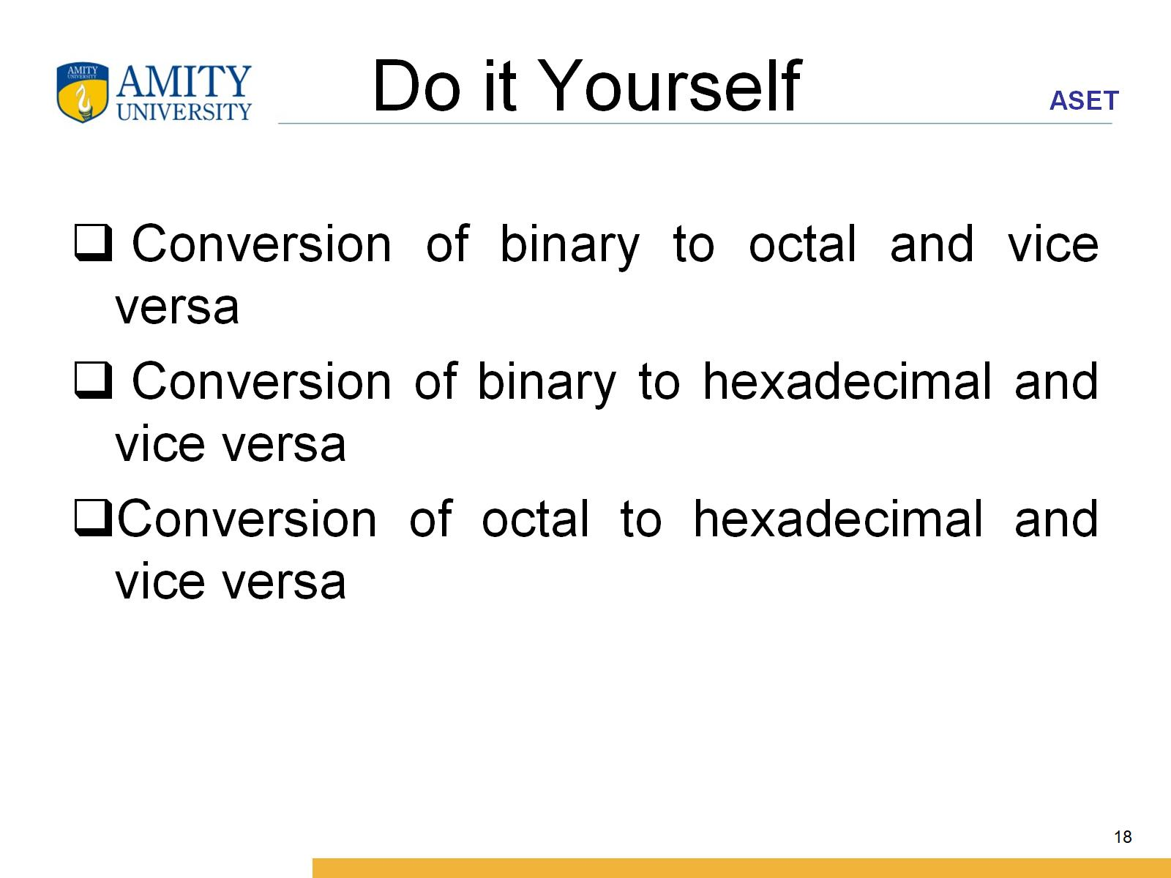
Do it Yourself

Slide 19
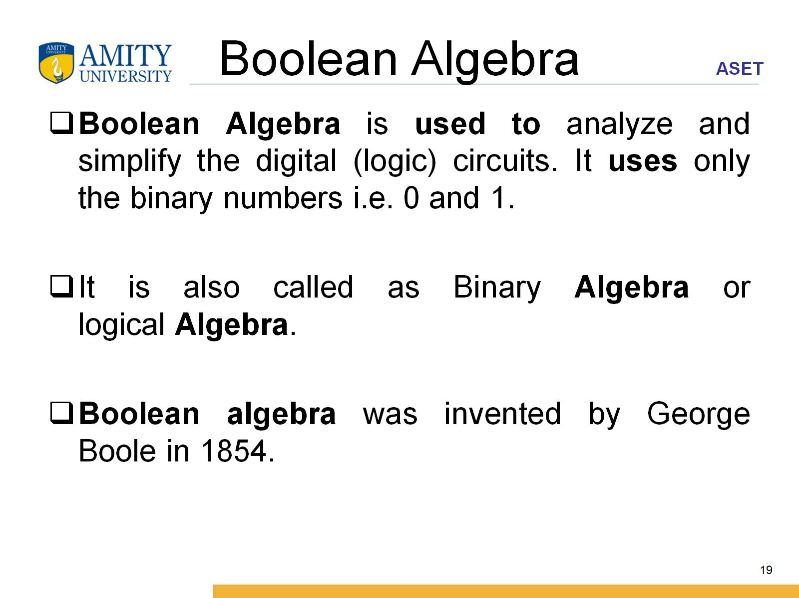
Boolean Algebra

Slide 20
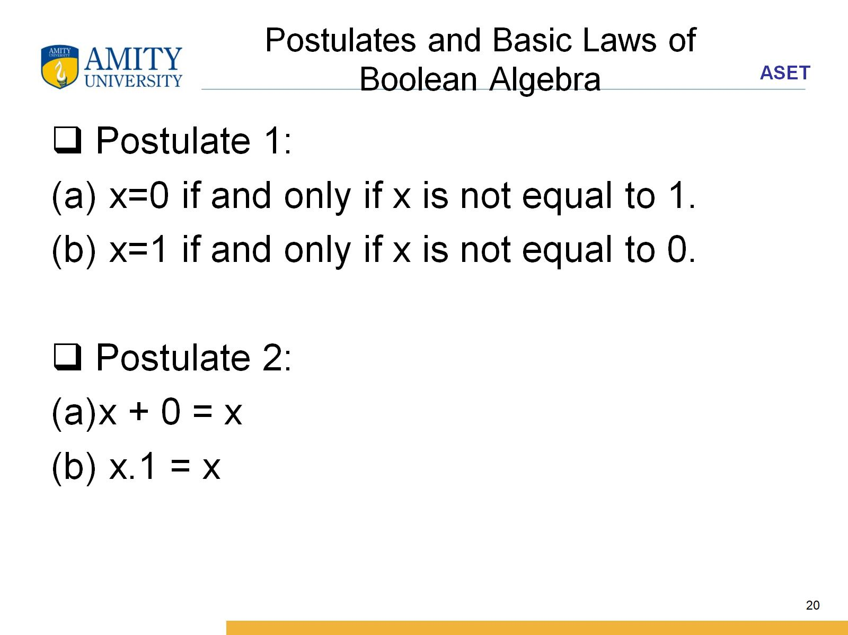
Postulates and Basic Laws of Boolean Algebra

Slide 21
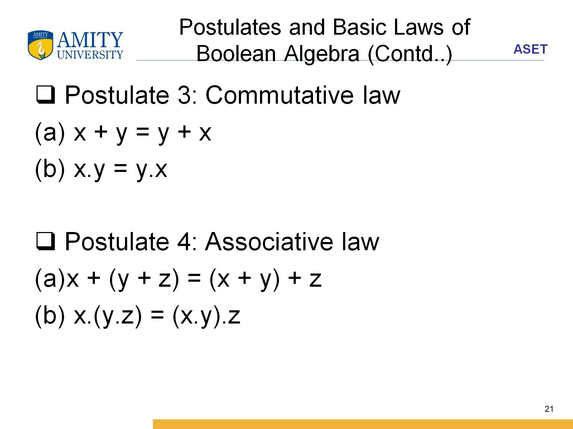
Postulates and Basic Laws of Boolean Algebra (Contd..)

Slide 22
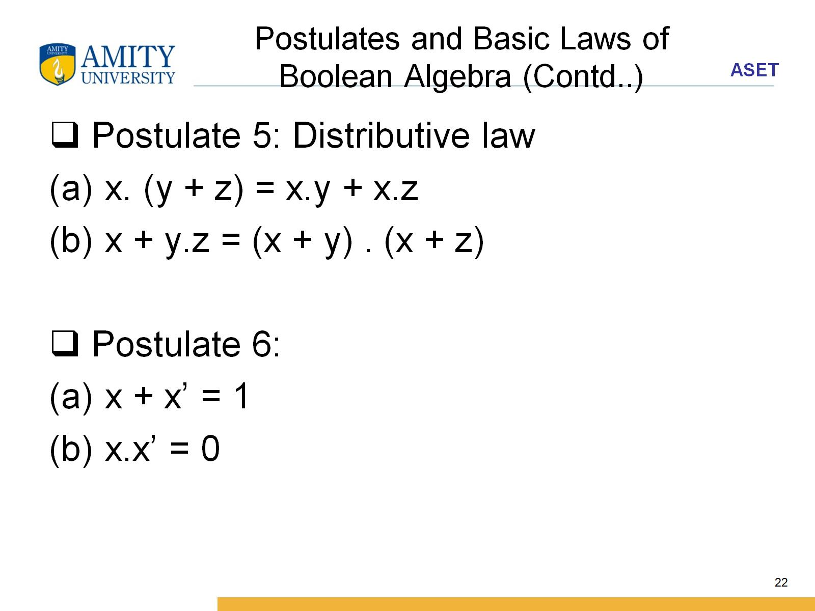
Postulates and Basic Laws of Boolean Algebra (Contd..)

Slide 23
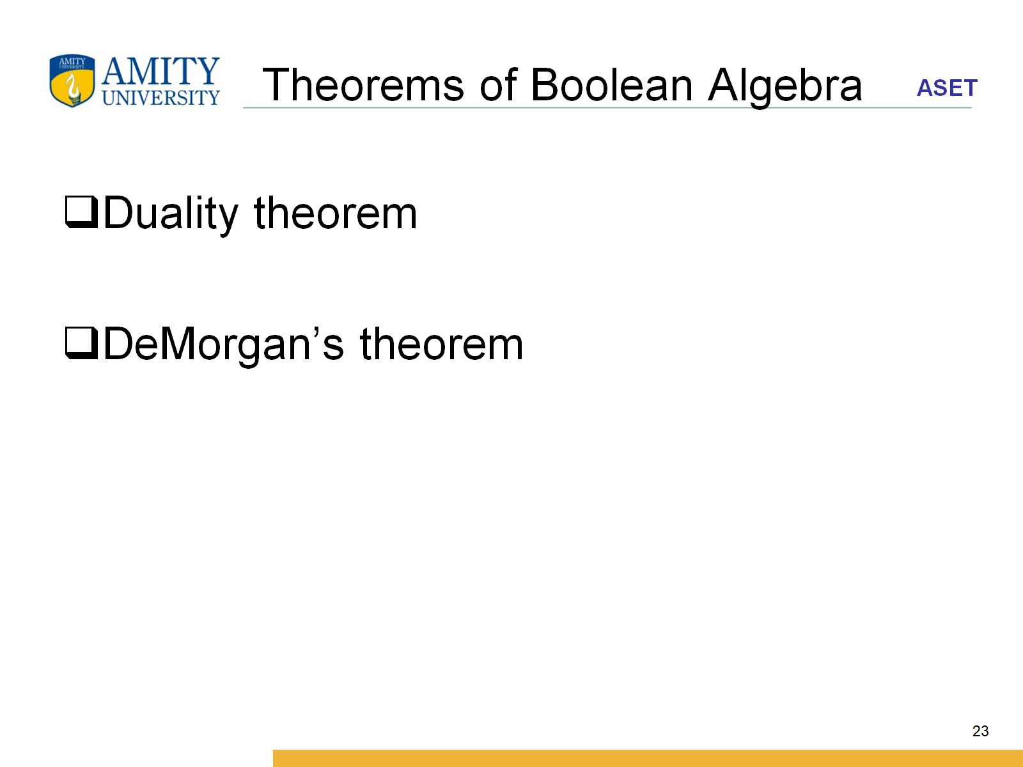
Theorems of Boolean Algebra

Slide 24
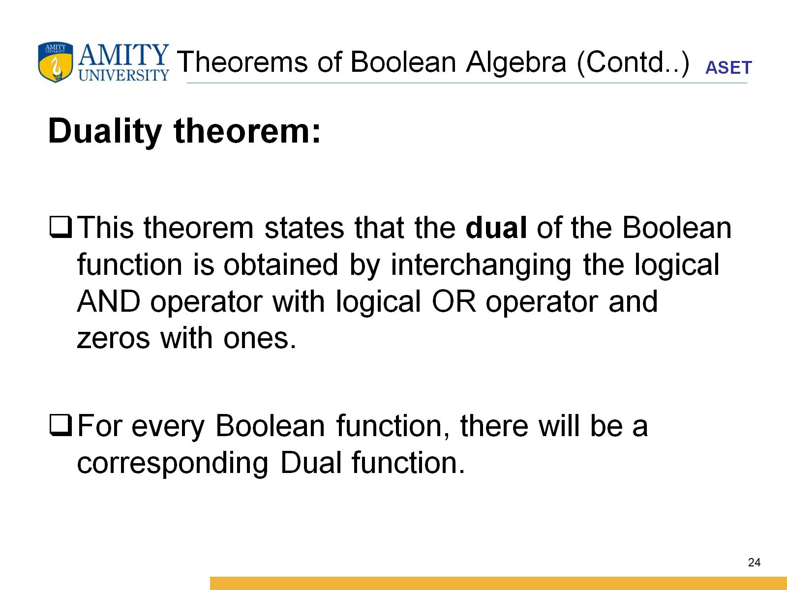
Theorems of Boolean Algebra (Contd..)

Slide 25
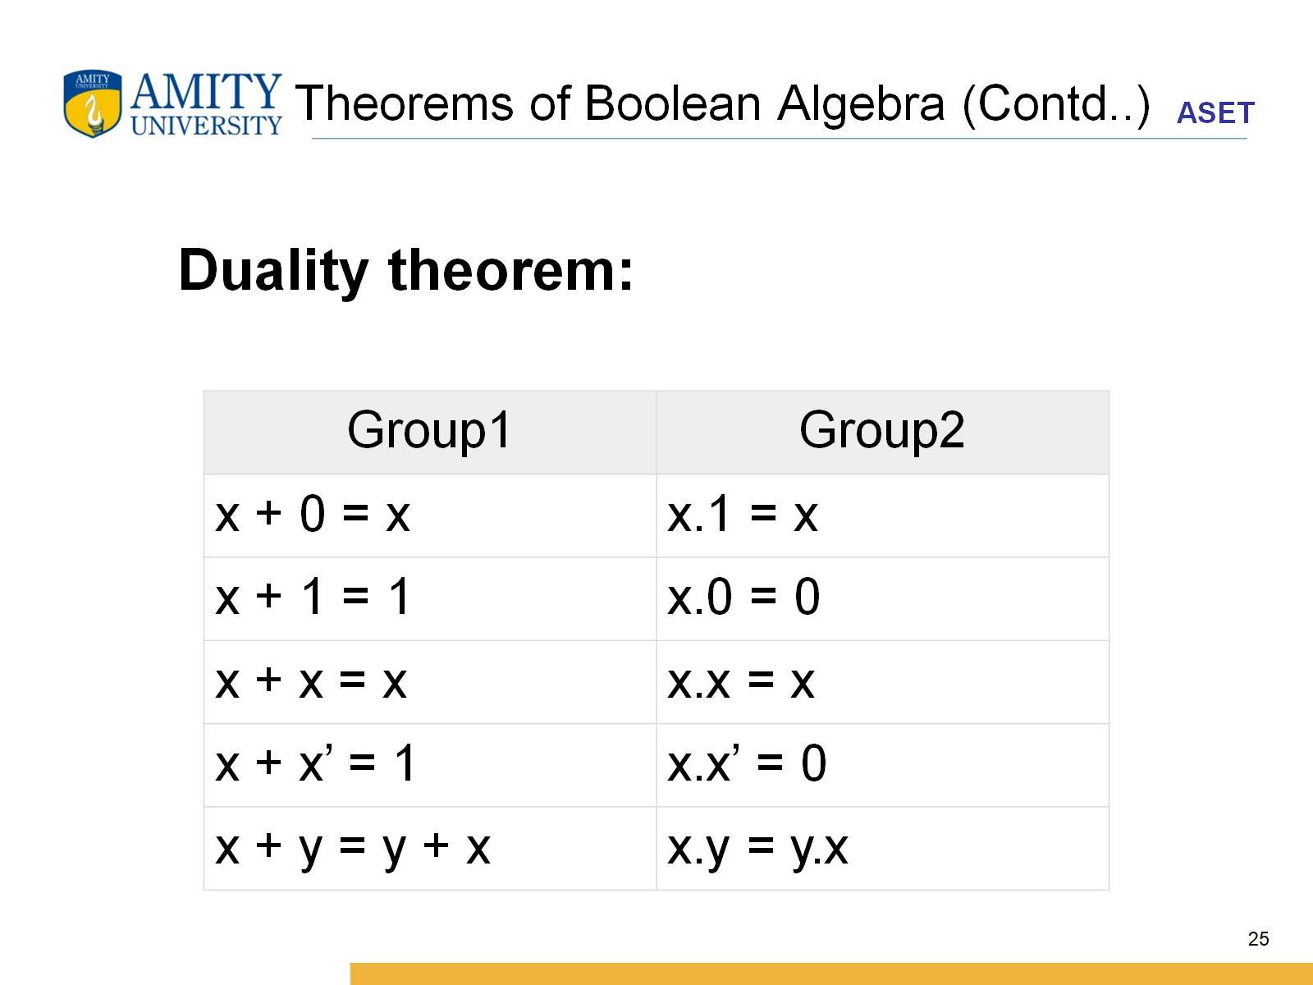
Theorems of Boolean Algebra (Contd..)

Slide 26
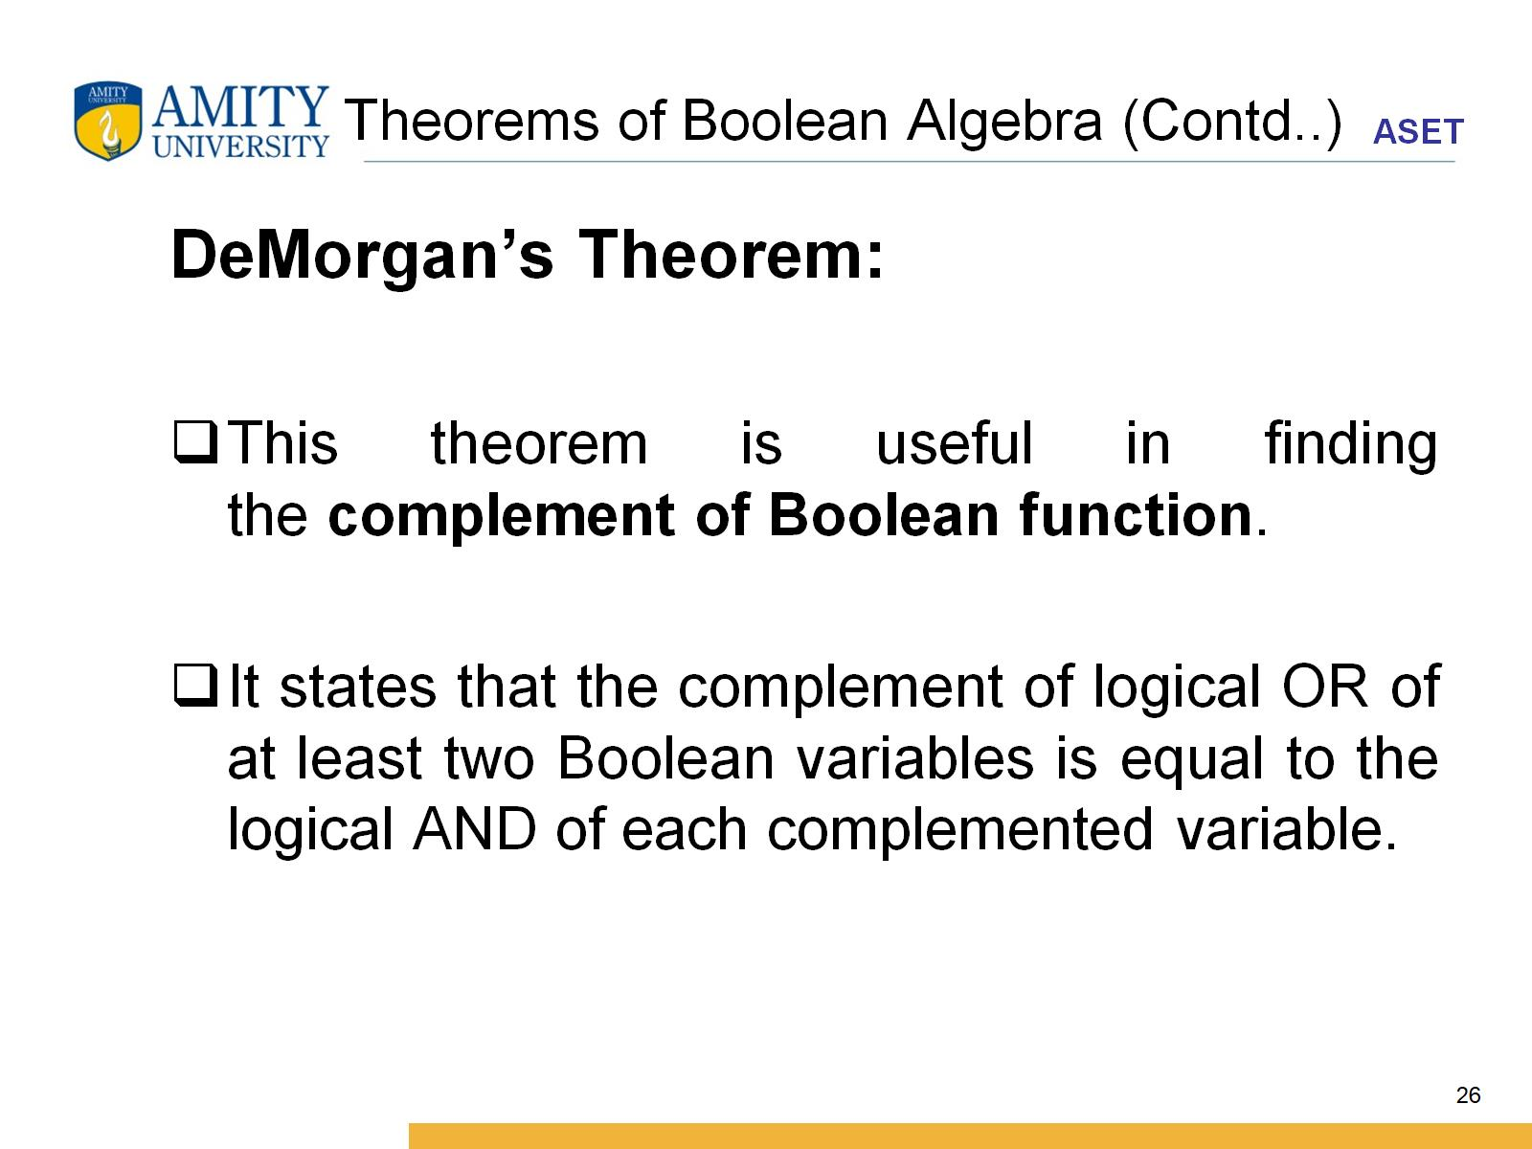
Theorems of Boolean Algebra (Contd..)

Slide 27
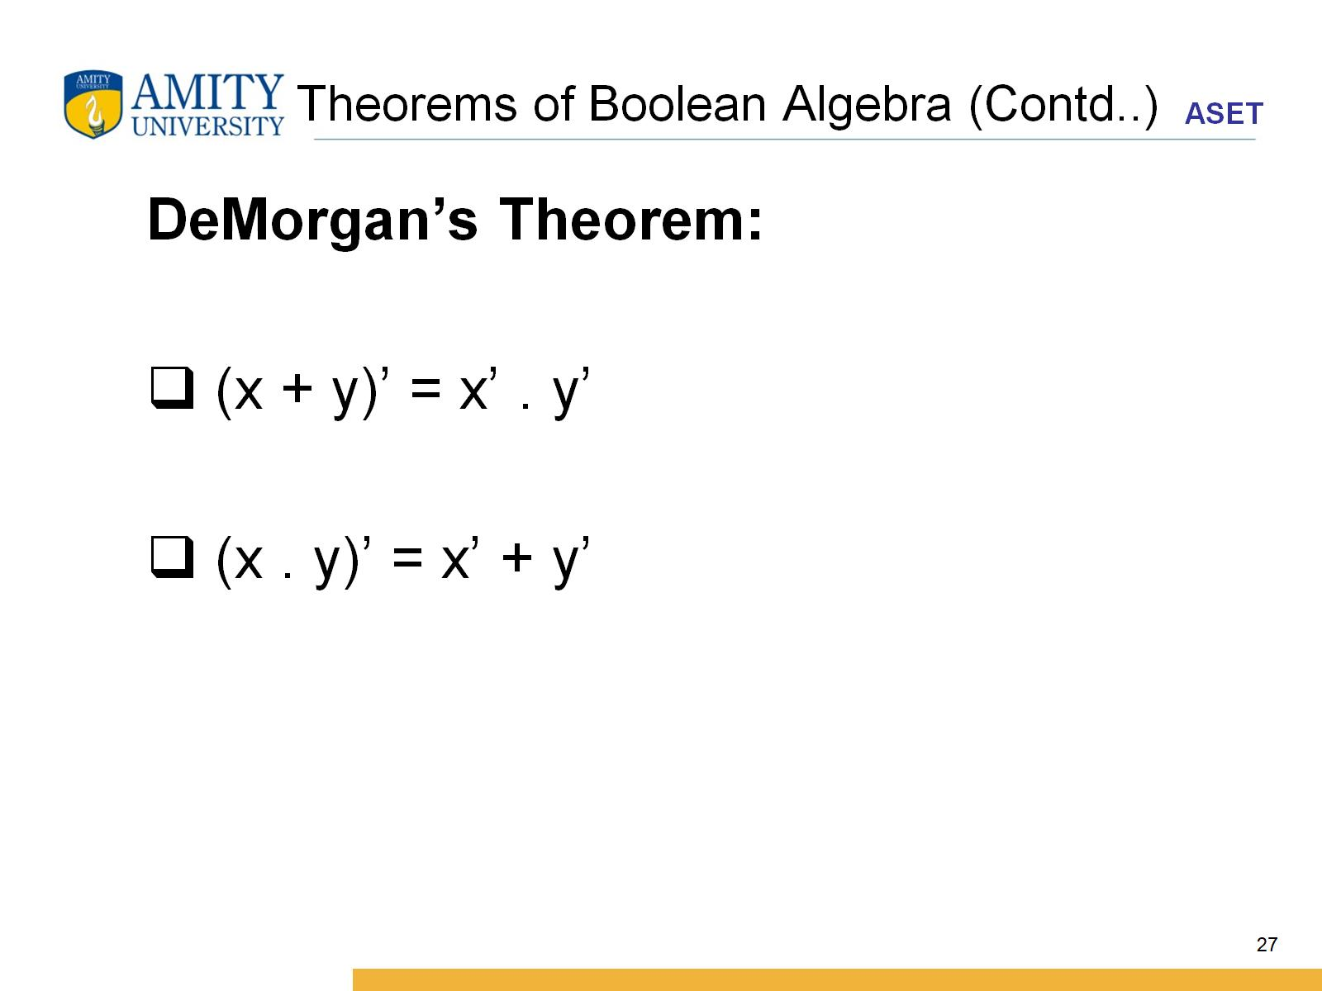
Theorems of Boolean Algebra (Contd..)

Slide 28
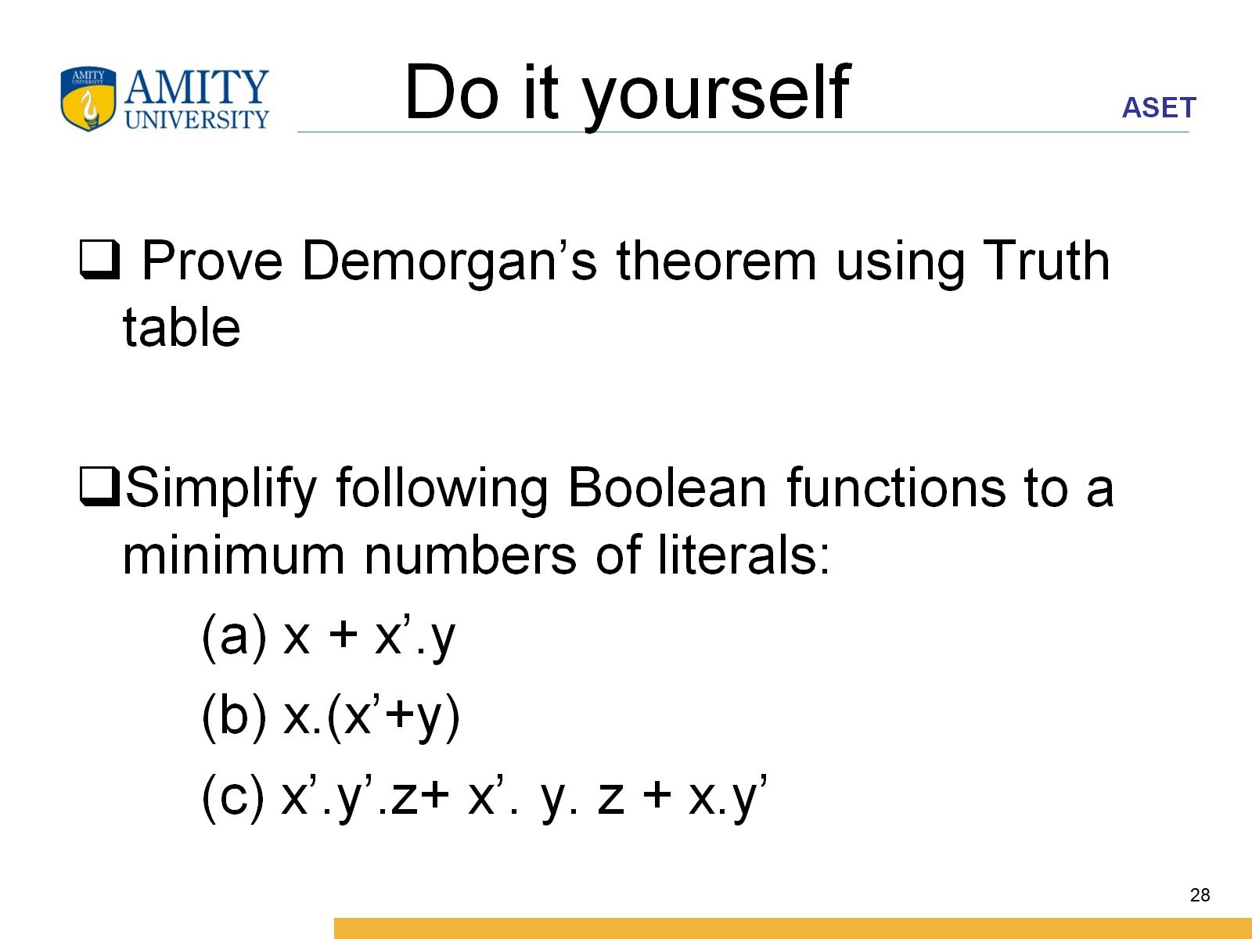
Do it yourself

Slide 29
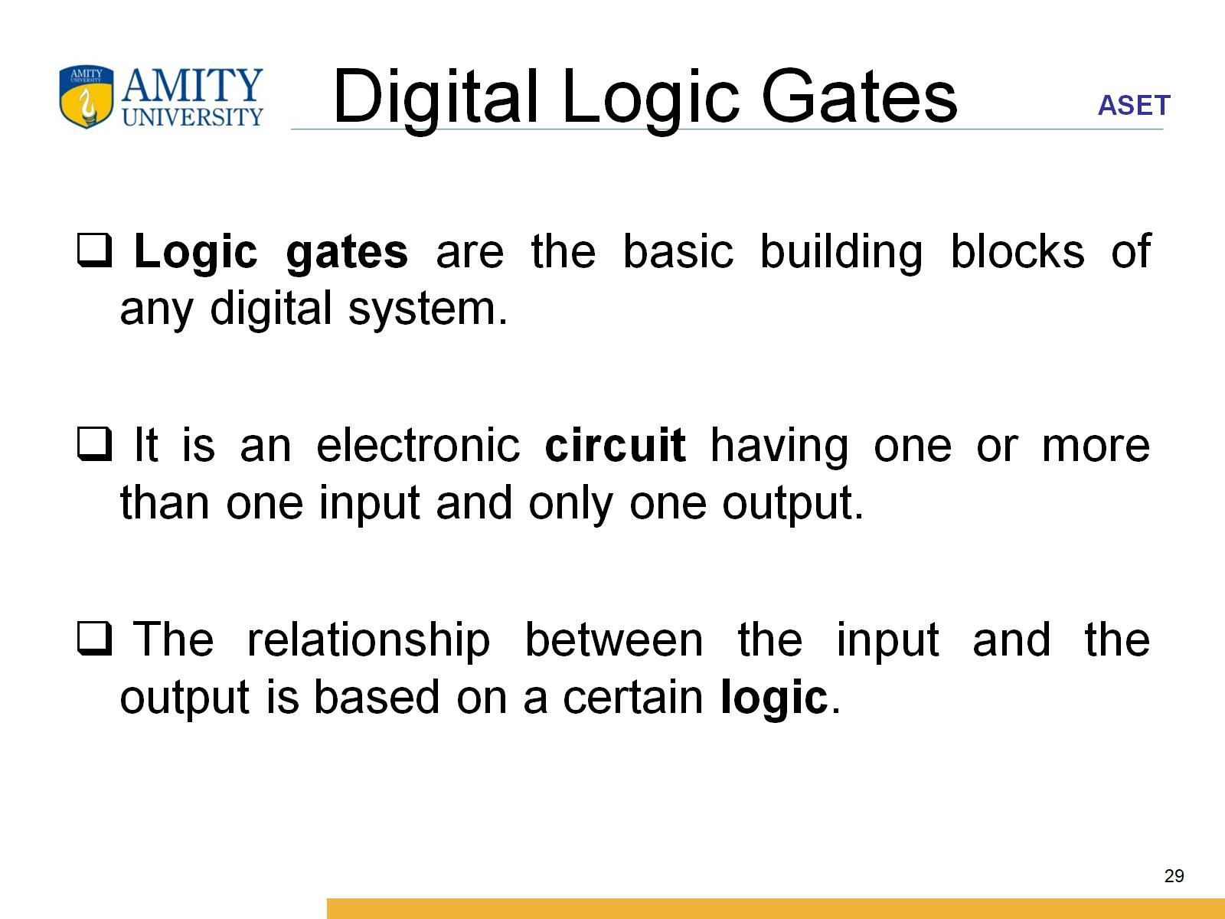
Digital Logic Gates

Slide 30
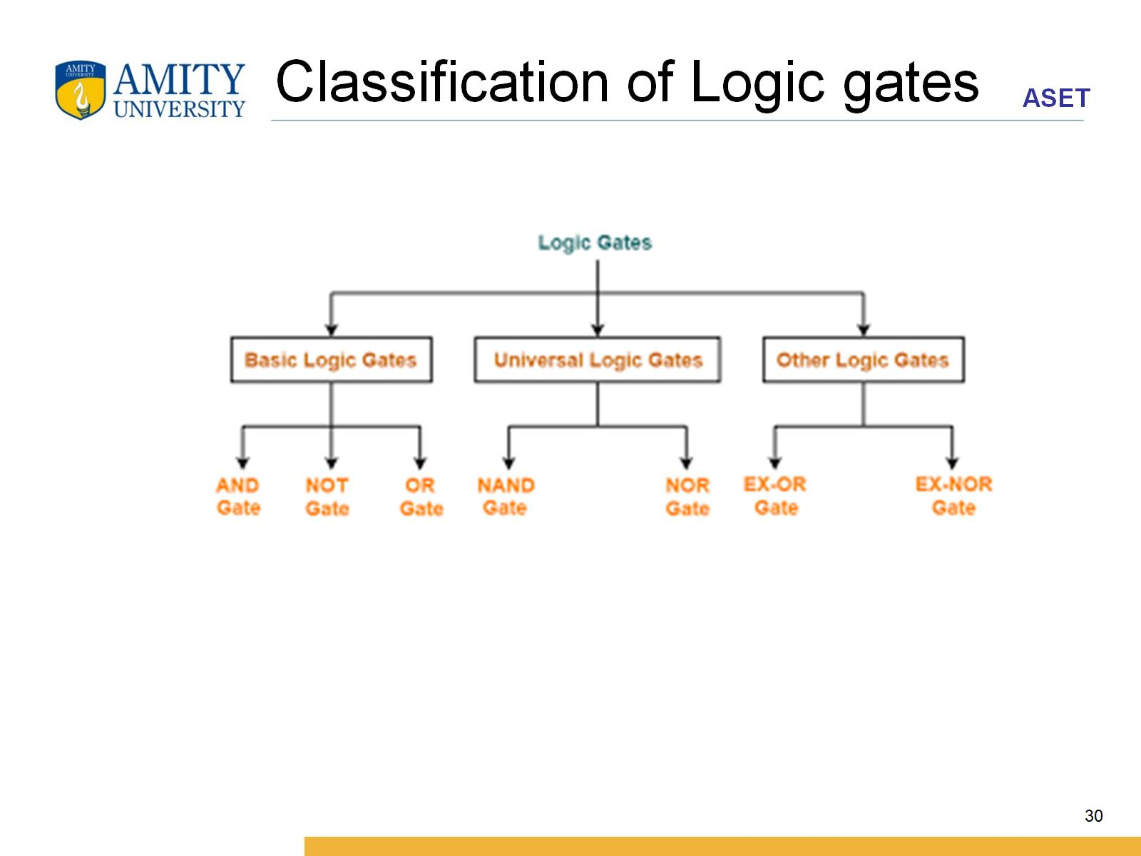
Classification of Logic gates

Slide 31
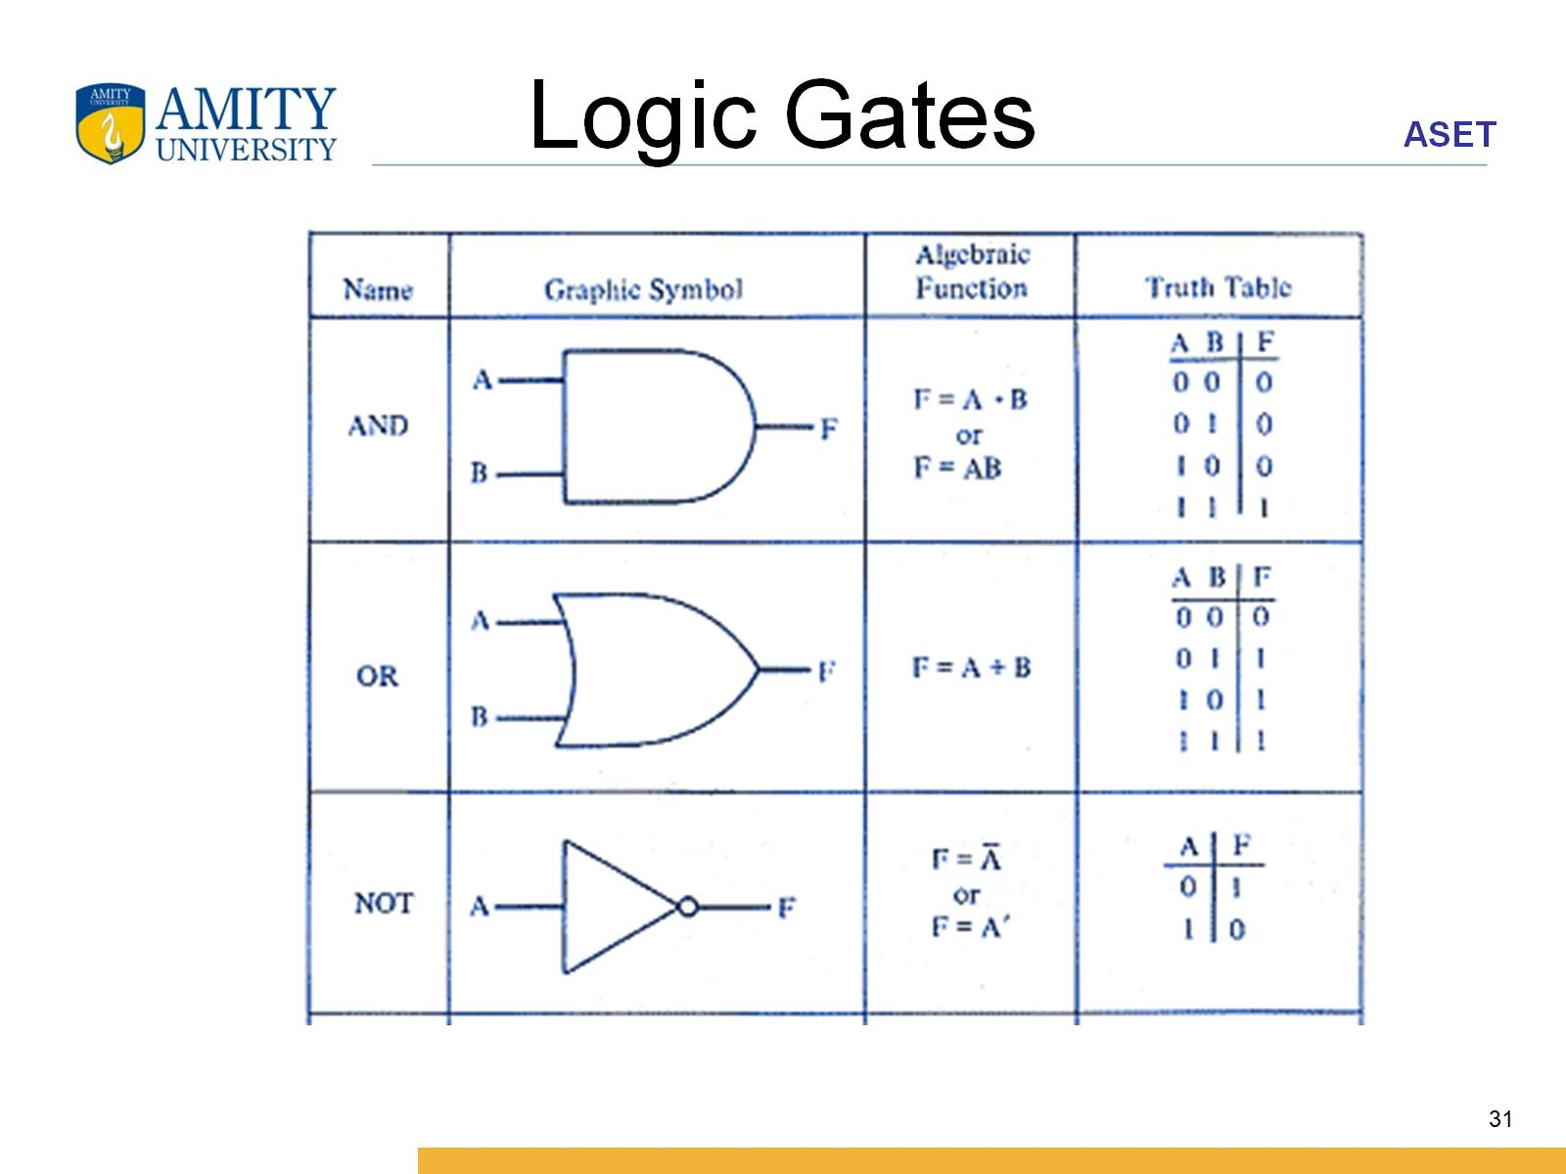
Logic Gates

Slide 32
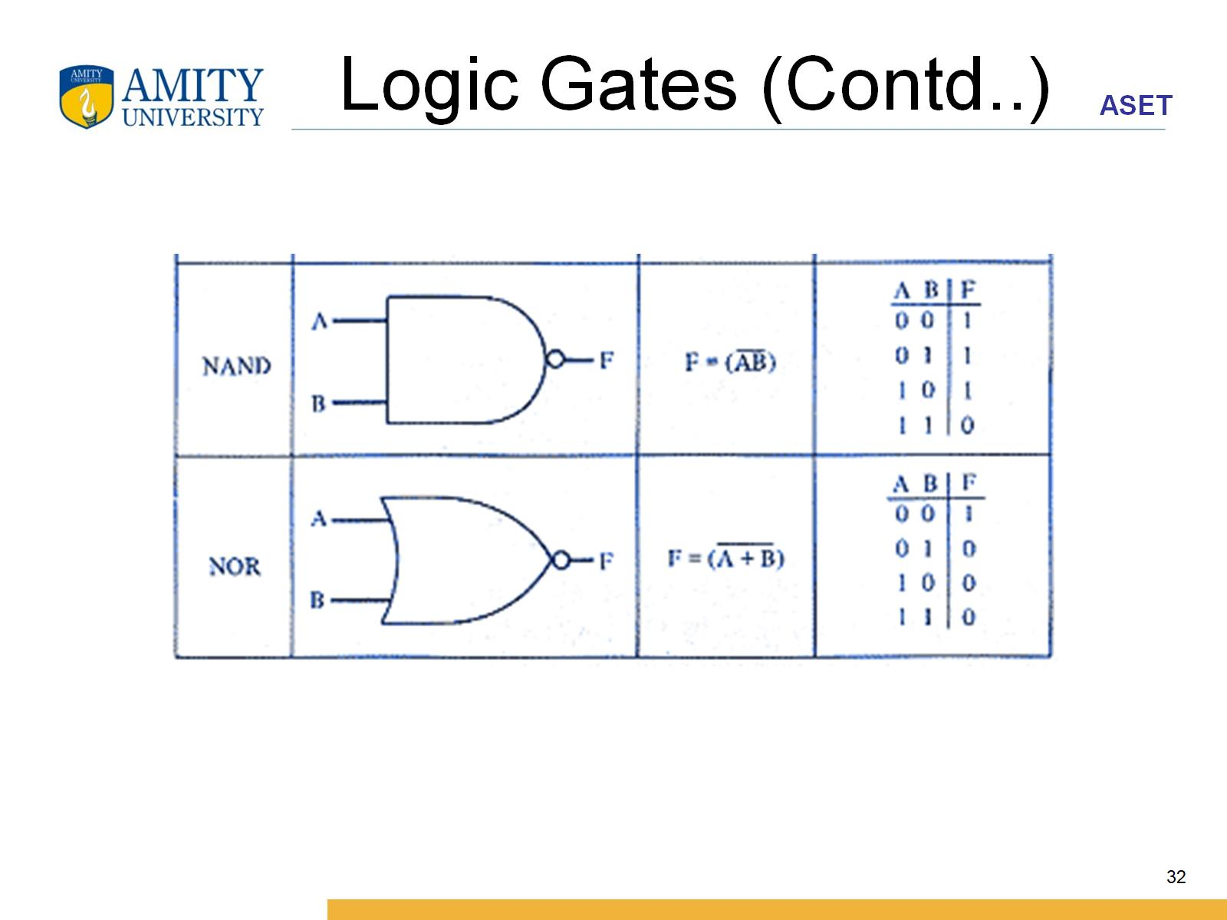
Logic Gates (Contd..)

Slide 33
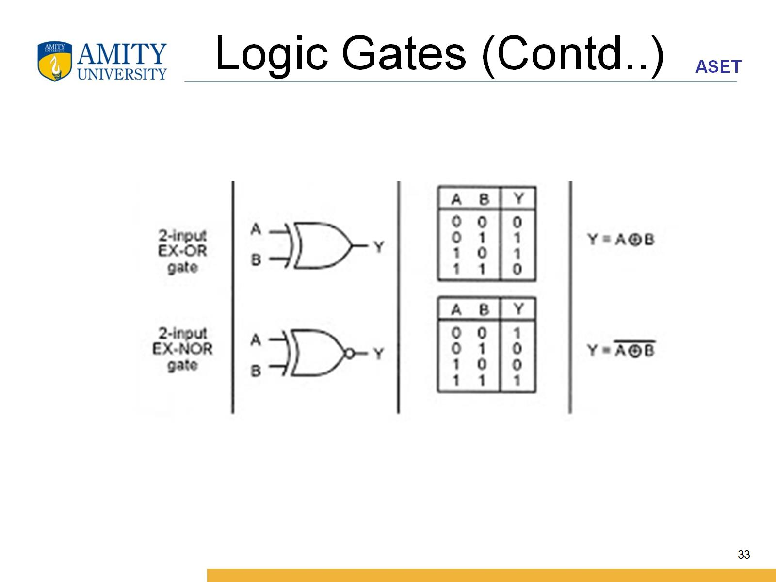
Logic Gates (Contd..)

Slide 34
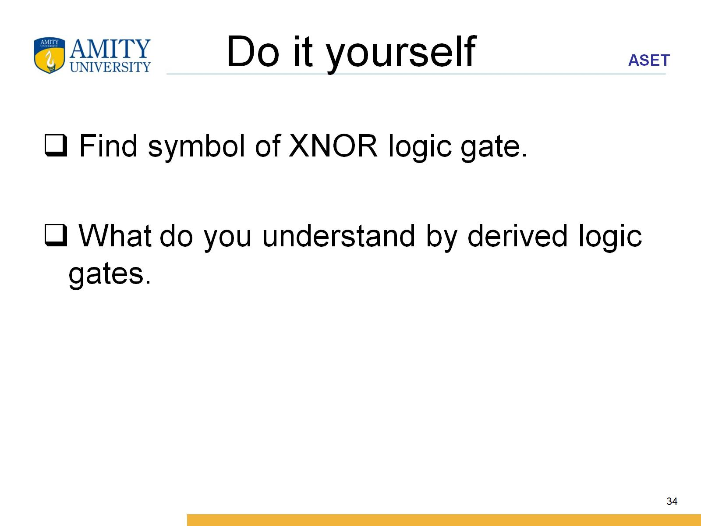
Do it yourself

Slide 35
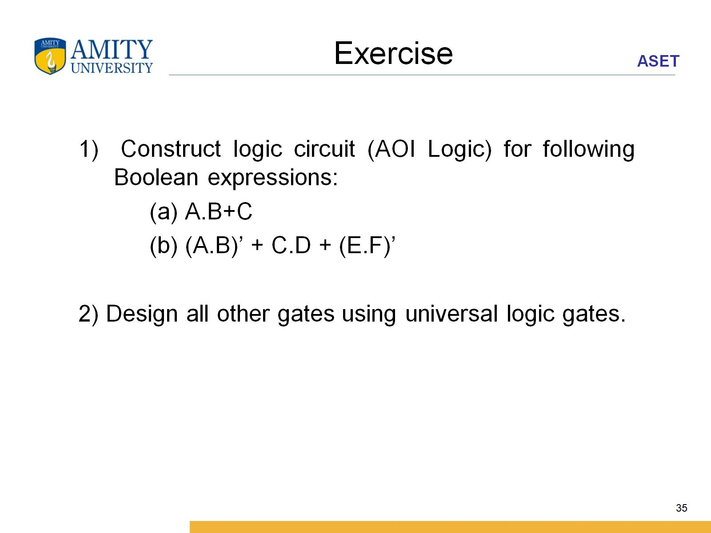
Exercise

